Slide 1
Lending Club Case Study
Submission
Team:
Vikram Pawar

Slide 2
Index
What is this case study about?
Problem Statement
Business Objective
Analysis Approach
Analysis
Conclusion
Recommendation on driving factors influencing tendency of default

Slide 3
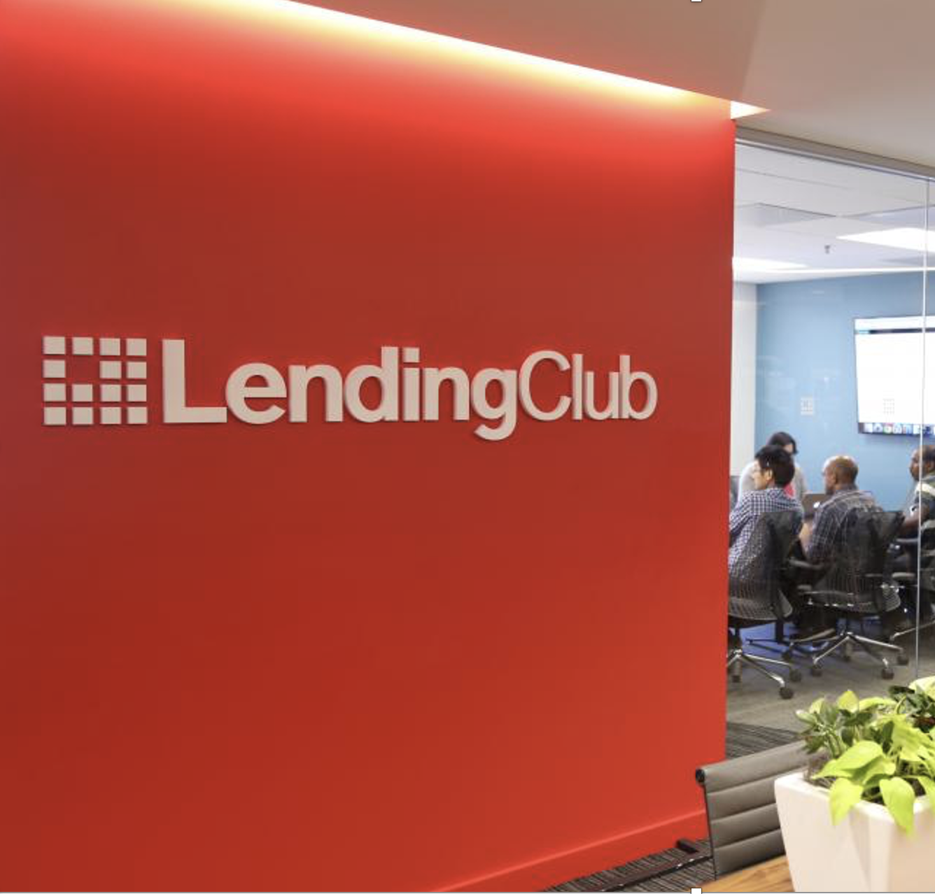
What is this case study about?
In this case study, we are working on applying the knowledge of Exploratory Data Analysis gained to understand how consumer and loan attributes influence the tendency of default for the Lending Club using dataset which includes complete loan data for all loans issued by Lending Club through the time period 2007 t0 2011.
Finally we would have to recommend driving factors (or driver variables) behind loan default which company can for its portfolio and risk assessment.

Slide 4
Problem Statement
LendingClub is an online peer-to-peer lending platform that connects borrowers and investors.The platform operates as an intermediary, facilitating loans between individual borrowers and investors who are seeking to earn interest on their funds.
Borrowers who are seeking personal loans can apply for loans through LendingClub's website. The platform evaluates the creditworthiness of the applicants using various factors, including credit history, income, and debt-to-income ratio. Approved borrowers are then assigned an interest rate based on their credit profile.
Two types of risks associated with the Lending Club’s decision:
If the applicant is likely to repay the loan, then not approving the loan results in a loss of business to the company
If the applicant is not likely to repay the loan, i.e. he/she is likely to default, then approving the loan may lead to a financial loss for the company
Like most other lending companies, lending loans to ‘risky’ applicants is the largest source of financial loss (called credit loss). The credit loss is the amount of money lost by the lender when the borrower refuses to pay or runs away with the money owed. In other words, borrowers who default cause the largest amount of loss to the lenders. In this case, the customers labelled as 'charged-off' are the 'defaulters'.

Slide 5
Business Objective
The goal is to identify these risky loan applicants, then risky loans can be reduced thereby cutting down the amount of credit loss. Identification of such applicants using EDA is the aim of this case study.
In other words, the company wants to understand the driving factors (or driver variables) behind loan default, i.e. the variables which are strong indicators of default. The company can utilise this knowledge for its portfolio and risk assessment.

Slide 6
Analysis Approach
01
02
03
Data Cleaning
04
Univariate Analysis
Bivariate Analysis
Collect Insights
Rows Analysis
Column Analysis
Column removals
Data conversion
Outlier removal
Create Derived column
Analyse single variable as below
Quantitative Variables
Ordered Categorical Variables
Un-Ordered Categorical Variables
Derived Variables
Analyse influence of one variable on other as below
Categorical Variables
Quantitative Variables
Conclusion
Recommendation on driving factors

Slide 7
— Customer Attributes
Recommendation on driving factors influencing tendency of default
— Loan Attributes
term
The number of payments on the loan. Values are in months and can be either 36 or 60.
grade
LC assigned loan grade.
purpose
A category provided by the borrower for the loan request.
int_rate
Interest Rate on the loan
loan_amnt
The listed amount of the loan applied for by the borrower. If at some point in time, the credit department reduces the loan amount, then it will be reflected in this value.
funded_amnt
The total amount committed to that loan at that point in time.
dti
A ratio calculated using the borrower’s total monthly debt payments on the total debt obligations, excluding mortgage and the requested LC loan, divided by the borrower’s self-reported monthly income.
annual_inc
The self-reported annual income provided by the borrower during registration.

Slide 8
Thanks!
Have any questions?
Email: vikrampawar08@gmail.com
Phone: +91-9870731602
Linkedin: https://www.linkedin.com/in/vikrampawar88/

Slide 9
Contents of this template
You can delete this slide when you’re done editing the presentation
Fonts | To view this template correctly in PowerPoint, download and install the fonts we used
Used and alternative resources | An assortment of graphic resources that are suitable for use in this presentation
Thanks slide | You must keep it so that proper credits for our design are given
Colors | All the colors used in this presentation
Icons and infographic resources | These can be used in the template, and their size and color can be edited
Editable presentation theme | You can edit the master slides easily. For more info, click here
For more info: SLIDESGO | SLIDESGO SCHOOL | FAQs
You can visit our sister projects: FREEPIK | FLATICON | STORYSET | WEPIK | VIDEVO

Slide 10

Our team
Mercury is the closest planet to the Sun and the smallest one in the entire Solar System. This planet's name has nothing to do with the liquid metal, since Mercury was named after the Roman messenger god. Despite being closer to the Sun than Venus, its temperatures aren't as terribly hot as that planet's. Its surface is quite similar to that of Earth's Moon
Speaking of craters, many of them were named after artists or authors who made significant contributions to their respective fields. Mercury takes a little more than 58 days to complete its rotation, so try to imagine how long days must be there! Since the temperatures are so extreme, albeit not as extreme as in Venus, and the solar radiation is so high, Mercury has been deemed to be non-habitable for humans

Slide 11
Table of contents
01
02
03
Jupiter
Venus
Saturn
Jupiter is a gas giant and the biggest planet in the Solar System. It's the fourth-brightest object in the night sky. It was named after the Roman god of the skies and lightning
Venus has a beautiful name and is the second planet from the Sun. It’s terribly hot and its atmosphere is poisonous. It’s the second-brightest natural object in the night sky
Saturn is a gas giant and has rings. It's composed mostly of hydrogen and helium. It was named after the Roman god of wealth and agriculture. It’s the sixth planet from the Sun

Slide 12
01
Name of the section
You can enter a subtitle here if you need it

Slide 13
—Someone Famous
“This is a quote, words full of wisdom that someone important said and can make the reader get inspired.”

Slide 14
Maybe you need to divide the content
Jupiter and Mars
Venus and Mercury
Jupiter is a gas giant and the biggest planet in the Solar System. It's the fourth-brightest object in the night sky. It was named after the Roman god of the skies and lightning
Despite being red, Mars is actually a cold place. It's full of iron oxide dust
Venus has a beautiful name and is the second planet from the Sun. It’s terribly hot, even hotter than Mercury, and its atmosphere is extremely poisonous
Mercury is the closest planet to the Sun and the smallest one in the Solar System

Slide 15

You can use bullet points
Venus has a beautiful name and is the second planet from the Sun. It’s terribly hot, even hotter than Mercury, and its atmosphere is extremely poisonous. It’s the second-brightest natural object in the night sky after the Moon
Earth is the third planet from the Sun and the only one that harbors life in the Solar System. We all live on it!
Jupiter is a gas giant and the biggest planet in the Solar System. It's the fourth-brightest object in the night sky. It was named after the Roman god of the skies and lightning
Mercury is the smallest planet in the Solar System. It was named after the Roman messenger god
Despite being red, Mars is actually a cold place. It's full of iron oxide dust, which gives the planet its reddish cast

Slide 16
Infographics are always useful
01
02
03
04
Venus
Mars
Mercury is the smallest planet in the Solar System
Despite being red, Mars is a very cold place
Mercury
Jupiter
Venus is the second planet from the Sun
Jupiter is the biggest planet in the Solar System

Slide 17
A picture is worth a thousand words

Slide 18
Slide with longer text
Mercury is the closest planet to the Sun and the smallest of them all. This planet's name has nothing to do with the liquid metal, since Mercury was named after the Roman messenger god. Despite being closer to the Sun than Venus, its temperatures aren't as terribly hot as that planet's. Its surface is quite similar to that of Earth's Moon, which means there are a lot of craters and plains. Speaking of craters, many of them were named after artists or authors who made significant contributions to their respective fields. Mercury takes a little more than 58 days to complete its rotation, so try to imagine how long days must be there! Since the temperatures are so extreme, albeit not as extreme as in Venus, and the solar radiation is so high, Mercury has been deemed to be non-habitable for humans
Mercury is the closest planet to the Sun and the smallest of them all. This planet's name has nothing to do with the liquid metal, since Mercury was named after the Roman messenger god. Despite being closer to the Sun than Venus, its temperatures aren't as terribly hot as that planet's. Its surface is quite similar to that of Earth's Moon, which means there are a lot of craters and plains. Speaking of craters, many of them were named after artists or authors who made significant contributions to their respective fields. Mercury takes a little more than 58 days to complete its rotation, so try to imagine how long days must be there! Since the temperatures are so extreme, albeit not as extreme as in Venus, and the solar radiation is so high, Mercury has been deemed to be non-habitable for humans

Slide 19
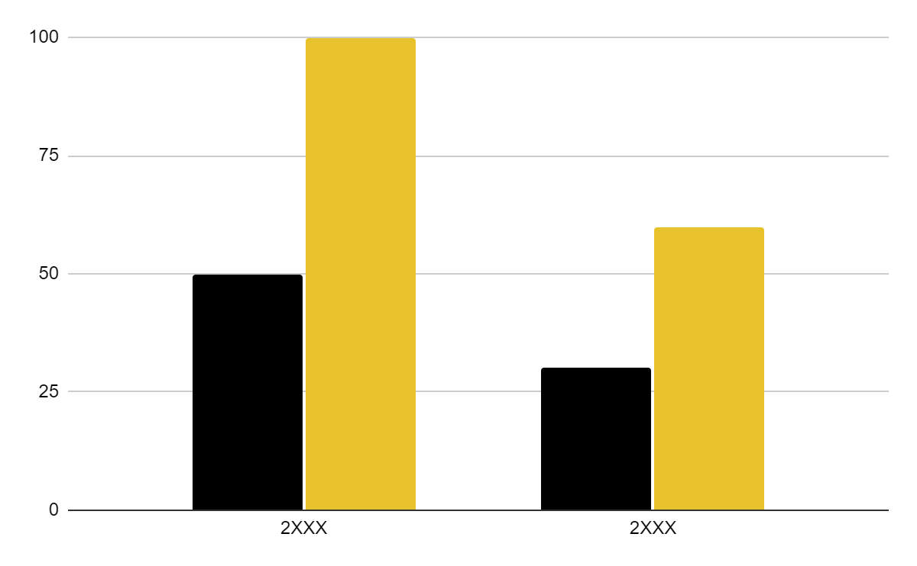
You can use this graph
Mercury
Jupiter
Mercury is the smallest planet of them all
Jupiter is the biggest planet of them all
Follow the link in the graph to modify its data and then paste the new one here. For more info, click here

Slide 20
Thanks!
Do you have any questions?
youremail@freepik.com
+34 654 321 432
yourwebsite.com
Please keep this slide for attribution

Slide 21
Alternative resources
Here’s an assortment of alternative resources whose style fits that of this template:

Slide 22
Resources
Did you like the resources on this template? Get them for free at our other websites:
Vectors
Lifestyle instagram post design template
Photos
Colleagues doing team work for a project I
Colleagues doing team work for a project II
Business woman banner concept with copy space

Slide 23
Instructions for use
If you have a free account, in order to use this template, you must credit Slidesgo by keeping the Thanks slide. Please refer to the next slide to read the instructions for premium users.
As a Free user, you are allowed to:
Modify this template.
Use it for both personal and commercial projects.
You are not allowed to:
Sublicense, sell or rent any of Slidesgo Content (or a modified version of Slidesgo Content).
Distribute Slidesgo Content unless it has been expressly authorized by Slidesgo.
Include Slidesgo Content in an online or offline database or file.
Offer Slidesgo templates (or modified versions of Slidesgo templates) for download.
Acquire the copyright of Slidesgo Content.
For more information about editing slides, please read our FAQs or visit Slidesgo School:
https://slidesgo.com/faqs and https://slidesgo.com/slidesgo-school

Slide 24
Instructions for use (premium users)
As a Premium user, you can use this template without attributing Slidesgo or keeping the Thanks slide.
You are allowed to:
Modify this template.
Use it for both personal and commercial purposes.
Hide or delete the “Thanks” slide and the mention to Slidesgo in the credits.
Share this template in an editable format with people who are not part of your team.
You are not allowed to:
Sublicense, sell or rent this Slidesgo Template (or a modified version of this Slidesgo Template).
Distribute this Slidesgo Template (or a modified version of this Slidesgo Template) or include it in a database or in any other product or service that offers downloadable images, icons or presentations that may be subject to distribution or resale.
Use any of the elements that are part of this Slidesgo Template in an isolated and separated way from this Template.
Register any of the elements that are part of this template as a trademark or logo, or register it as a work in an intellectual property registry or similar.
For more information about editing slides, please read our FAQs or visit Slidesgo School:
https://slidesgo.com/faqs and https://slidesgo.com/slidesgo-school

Slide 25
Fonts & colors used
This presentation has been made using the following fonts:
Playfair Display
(https://fonts.google.com/specimen/Playfair+Display)
Roboto
(https://fonts.google.com/specimen/Roboto)
#000000
#f0f0f0
#e7c22c
#ffffff

Slide 26





Storyset
Create your Story with our illustrated concepts. Choose the style you like the most, edit its colors, pick the background and layers you want to show and bring them to life with the animator panel! It will boost your presentation. Check out how it works.
Pana
Amico
Bro
Rafiki
Cuate

Slide 27
Use our editable graphic resources...
You can easily resize these resources without losing quality. To change the color, just ungroup the resource and click on the object you want to change. Then, click on the paint bucket and select the color you want. Group the resource again when you’re done. You can also look for more infographics on Slidesgo.

Slide 30
JANUARY
FEBRUARY
MARCH
APRIL
MAY
JUNE
PHASE 1
Task 1
Task 2
PHASE 2
Task 1
Task 2
JANUARY
FEBRUARY
MARCH
APRIL
PHASE 1
Task 1
Task 2

Slide 33
...and our sets of editable icons
You can resize these icons without losing quality.
You can change the stroke and fill color; just select the icon and click on the paint bucket/pen.
In Google Slides, you can also use Flaticon’s extension, allowing you to customize and add even more icons.

Slide 34
Educational Icons
Medical Icons

Slide 35
Business Icons
Teamwork Icons

Slide 36
Help & Support Icons
Avatar Icons

Slide 37
Creative Process Icons
Performing Arts Icons

Slide 38
Nature Icons

Slide 39
SEO & Marketing Icons

Slide 40


